Slide 1


Capstone Project Title/Name
G Uday Kumar
Bhaskar V P
Chethan Kumar M
Kashinath R
Sanjay S C
College Name - R L Jalappa Institute Of Technology
Notes:
Let's delve deeper into the exciting world of sustainability and AI.
In this chapter, we'll explore how artificial intelligence can be a powerful tool for addressing environmental challenges and promoting sustainable practices. We'll discuss specific applications of AI in various sectors and analyze its potential to drive positive change.
Get ready to discover the innovative ways AI is contributing to a more sustainable future!

Slide 2

Project Objectives
Problem Statement
Project Overview – Introduction
End Users
Wow Factor in Project
Modelling/Block Diagram/Flow of Project
Result/outcomes
Conclusion
Future Perspective
Notes:
Let's outline what you'll learn in this presentation.
By the end, you'll be able to:
Understand how AI helps solve problems like climate change, resource depletion, and biodiversity loss.
Identify key AI uses in energy efficiency, waste management, and climate change.
Analyze AI's role in sustainable agriculture and cities.
Evaluate AI's use in environmental monitoring using satellites, real-time data, and predictions.
Apply AI strategies in logistics and transportation to make them more sustainable.
Get ready to discover how AI can help create a greener future!

Slide 3
Problem Statement
With growing energy demand, predicting energy consumption accurately is essential for optimizing usage and reducing waste. Traditional forecasting methods often fail to adapt to dynamic consumption patterns and seasonal variations. EcoWatt addresses this by applying machine learning models to forecast energy usage based on historical data.
Notes:
Sustainability and AI
Sustainability is important because it helps meet our needs now and in the future. It includes protecting the environment, reducing pollution, and improving economic and social well-being.
AI can help us achieve sustainability. AI can process data, make predictions, and optimize systems to solve problems like resource management, environmental conservation, and energy efficiency.
Examples:
Smart grids: Reduce energy consumption.
Agriculture: Optimize water and fertilizer use.
Biodiversity: Monitor wildlife to protect biodiversity.
AI is a powerful tool for creating a more sustainable future.

Slide 4
Project Overview - Introduction
EcoWatt is a comprehensive ML-powered platform that forecasts energy consumption using time-series analysis. It provides both user and admin dashboards with features like data upload, visualization, forecasting, and model training, all integrated within an intuitive Streamlit web interface.
Notes:
Sustainability and AI
Sustainability is important because it helps meet our needs now and in the future. It includes protecting the environment, reducing pollution, and improving economic and social well-being.
AI can help us achieve sustainability. AI can process data, make predictions, and optimize systems to solve problems like resource management, environmental conservation, and energy efficiency.
Examples:
Smart grids: Reduce energy consumption.
Agriculture: Optimize water and fertilizer use.
Biodiversity: Monitor wildlife to protect biodiversity.
AI is a powerful tool for creating a more sustainable future.

Slide 5
End Users
Residential consumers for personal energy tracking
Industrial sectors to optimize load management
Utility providers for demand forecasting
Government and research organizations for energy analytics
Notes:
Sustainability and AI
Sustainability is important because it helps meet our needs now and in the future. It includes protecting the environment, reducing pollution, and improving economic and social well-being.
AI can help us achieve sustainability. AI can process data, make predictions, and optimize systems to solve problems like resource management, environmental conservation, and energy efficiency.
Examples:
Smart grids: Reduce energy consumption.
Agriculture: Optimize water and fertilizer use.
Biodiversity: Monitor wildlife to protect biodiversity.
AI is a powerful tool for creating a more sustainable future.

Slide 6
Wow Factors in Project
Real-time forecasting through Streamlit web interface
Synthetic data generation for testing models
Admin dashboard for user and model management
Visualized results and CSV export functionality
IoT compatibility using MQTT for future integration
Notes:
Sustainability and AI
Sustainability is important because it helps meet our needs now and in the future. It includes protecting the environment, reducing pollution, and improving economic and social well-being.
AI can help us achieve sustainability. AI can process data, make predictions, and optimize systems to solve problems like resource management, environmental conservation, and energy efficiency.
Examples:
Smart grids: Reduce energy consumption.
Agriculture: Optimize water and fertilizer use.
Biodiversity: Monitor wildlife to protect biodiversity.
AI is a powerful tool for creating a more sustainable future.

Slide 7
Modelling/Block Diagram/Flow of Project
Flow of Project: 1. Data Collection (Synthetic/Uploaded) 2. Preprocessing & Feature Engineering 3. Model Training using Linear Regression 4. Forecast Generation 5. Data Visualization & Export 6. Admin & User Management
Notes:
Sustainability and AI
Sustainability is important because it helps meet our needs now and in the future. It includes protecting the environment, reducing pollution, and improving economic and social well-being.
AI can help us achieve sustainability. AI can process data, make predictions, and optimize systems to solve problems like resource management, environmental conservation, and energy efficiency.
Examples:
Smart grids: Reduce energy consumption.
Agriculture: Optimize water and fertilizer use.
Biodiversity: Monitor wildlife to protect biodiversity.
AI is a powerful tool for creating a more sustainable future.

Slide 8
Result/Outcomes
Accurate energy consumption forecasting with linear regression model
Interactive dashboard for visualization
Easy CSV export and data handling
High usability for both admins and end-users
GitHub Repository link
https://github.com/G-uday-kumar/EcoWatt-Smart-Energy-Consumption-Forecasting.git
Notes:
Sustainability and AI
Sustainability is important because it helps meet our needs now and in the future. It includes protecting the environment, reducing pollution, and improving economic and social well-being.
AI can help us achieve sustainability. AI can process data, make predictions, and optimize systems to solve problems like resource management, environmental conservation, and energy efficiency.
Examples:
Smart grids: Reduce energy consumption.
Agriculture: Optimize water and fertilizer use.
Biodiversity: Monitor wildlife to protect biodiversity.
AI is a powerful tool for creating a more sustainable future.

Slide 9
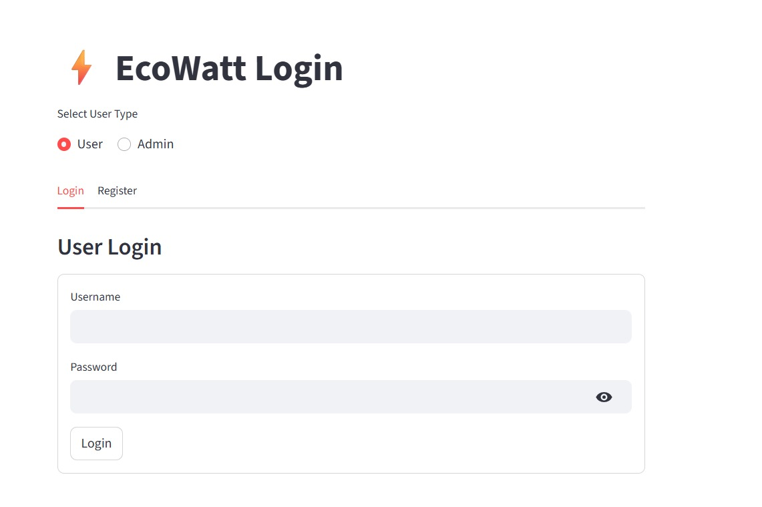
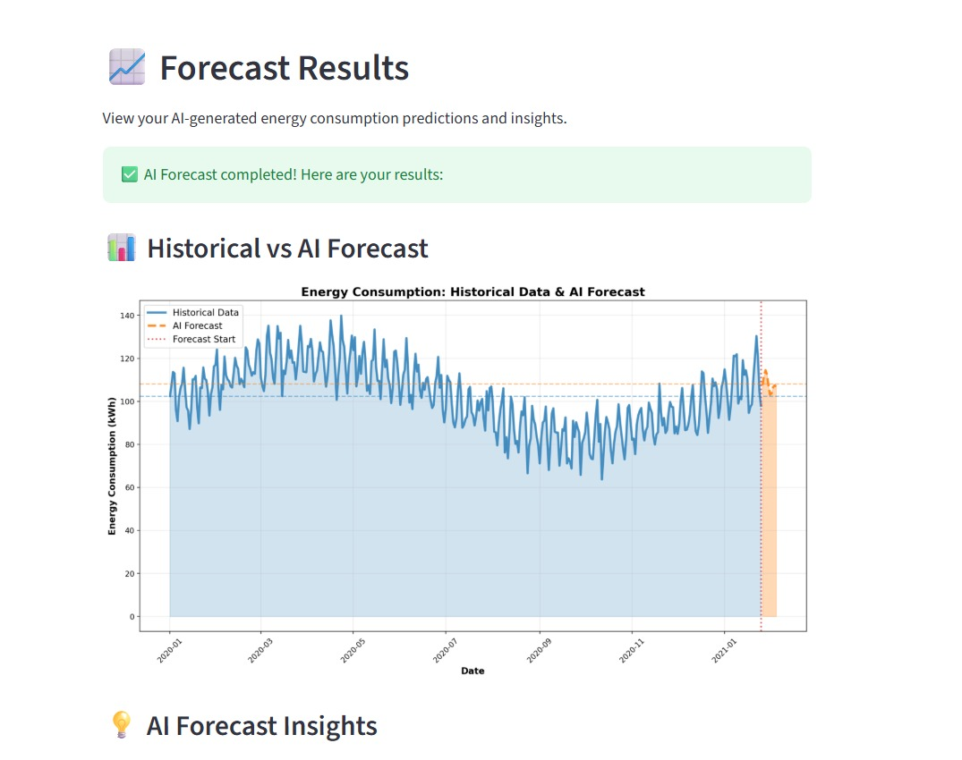
Frontend Page
Result

Slide 10
Conclusion
EcoWatt demonstrates how machine learning can transform traditional energy management systems. It offers accurate, real-time forecasting and provides an accessible web interface for users to manage and interpret their data efficiently.
Notes:
Sustainability and AI
Sustainability is important because it helps meet our needs now and in the future. It includes protecting the environment, reducing pollution, and improving economic and social well-being.
AI can help us achieve sustainability. AI can process data, make predictions, and optimize systems to solve problems like resource management, environmental conservation, and energy efficiency.
Examples:
Smart grids: Reduce energy consumption.
Agriculture: Optimize water and fertilizer use.
Biodiversity: Monitor wildlife to protect biodiversity.
AI is a powerful tool for creating a more sustainable future.

Slide 11
Future Perspective
Irate IoT sensors for integeal-time data collection
Deploy deep learning models (LSTM, RNN)
Expand to renewable energy forecasting
Mobile app integration for broader accessibility
Notes:
Sustainability and AI
Sustainability is important because it helps meet our needs now and in the future. It includes protecting the environment, reducing pollution, and improving economic and social well-being.
AI can help us achieve sustainability. AI can process data, make predictions, and optimize systems to solve problems like resource management, environmental conservation, and energy efficiency.
Examples:
Smart grids: Reduce energy consumption.
Agriculture: Optimize water and fertilizer use.
Biodiversity: Monitor wildlife to protect biodiversity.
AI is a powerful tool for creating a more sustainable future.

Slide 12
Thank You
Notes:
Thank You !!

